Slide 1
TEAM MANAGEMENT AND MANAGERIAL DECISION MAKING
DAY-(4)

Slide 2
CONTENTS
Concept of Decision Making
Steps of Decision-Making
Functions of Management
Types of Decision-Making
Models of Decision Making
Levels of Management and Decision Making
Pros and Cons

Slide 3

CONCEPT(1)

Slide 4

CONCEPT(2)

Slide 5

CONCEPT(3)

Slide 6
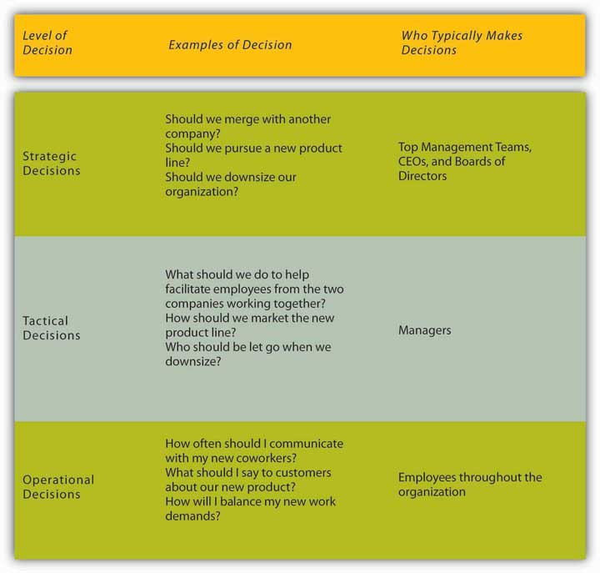

Slide 7
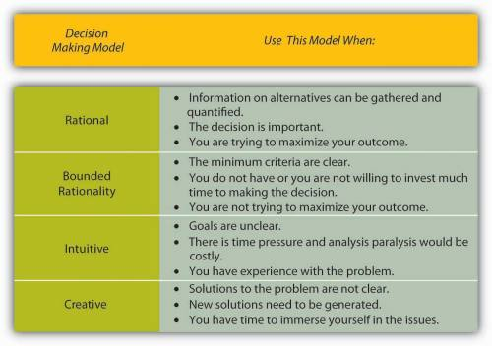

Slide 8
STEPS OF DECISION-MAKING
Creation of common space
Perception
Interpretation
Judgment
Motivation
Action
Reflection in action

Slide 9


Slide 10
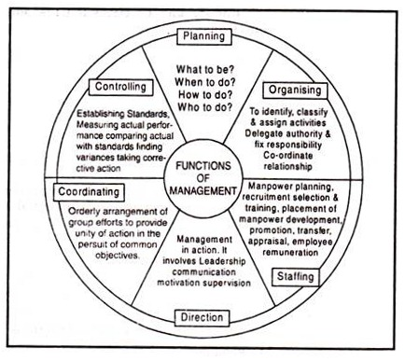
FUNCTIONS OF MANAGEMENT
CONTINUED…

Slide 11
“Planning involves the most significant and far-reaching decisions a manager can make. When managers plan, they decide such matters as what goals or opportunities their organisation will pursue, what resources they will use, and who will perform each required task. When plans go wrong or out of track, managers have to decide what to do to correct the deviation. In fact, the whole planning process involves managers constantly in a series of decision-making situations. How good their decisions are will largely determine how effective their plan will be.”

Slide 12
TYPES OF DECISION-MAKING
Programmed Decision Making
Heuristics
Non-Programmed Decision-Making

Slide 13
MODELS OF DECISION MAKING
The Vroom-Yetton-Jago Decision Model
Decision Quality
Subordinate commitment
Time constraintS
The OODA Loop
OBSERVE
ORIENT
DECIDE
ACT

Slide 14
The Recognition-Primed Decision Model
Experiencing the situation.
Analyzing the situation.
Implementing the decision.
Paired Comparison Analysis
The Ladder of Inference
Reality and facts
Selected reality
Interpreted reality
Assumptions
Conclusions
Beliefs
Actions

Slide 15

VIDEO ON DECISION MAKING

Slide 16
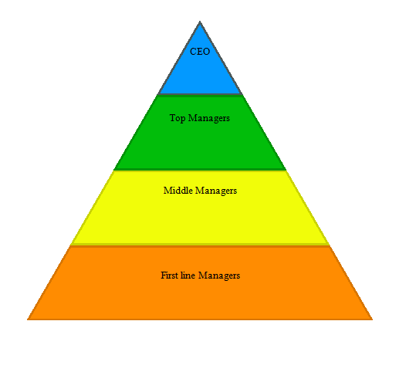
LEVELS OF MANAGEMENT AND THEIR DECISION MAKING PROCESS

Slide 17
CONTINUED….
Board or Owner Creates the Mission
Upper Management Needs a Strategic Plan
Middle Management Accomplish Strategic Goals
First-Line or Operational Management

Slide 18
6 STRATEGIES FOR IMPROVED DECISION MAKING
Use Perspective Decision-Making
Aquire expertise
Debias your judgement
Reason analogically
Take outsider’s view and (accept both the positive and negative part in the suggestions)
Understand biases in others

Slide 19
PROS OF DECISION MAKING
More information
Diversity of views
Greater acceptability
Expert opinions
Degree of involvement
Encourages people’s participation

Slide 20
CONS OF DECISION MAKING
Time-consuming
Lack of onus
Individual domination
Compromise decisions
Expensive
Groupism

Slide 21


Slide 22


Slide 23

QUESTIONS

Slide 24


